Slide 1
U.S. Fish and Wildlife Service
Careers with the Federal Government

Slide 2
U.S. Fish and Wildlife Service (FWS)
Helpful tips – Searching on USAJOBS
Agency tab for US Fish and Wildlife (also under Department tab under “I” for Interior along with other Department of Interior agencies)
Appointment Types
Temporary (great for students since some are not year-round positions)
Term (great for right after graduation if not able to secure a permanent position; after 24 months of employment, you are eligible for jobs posted open only to federal employees; these jobs are posted as Land & Base Management)
Permanent (great for long-term career)
LAND & BASE MANAGEMENT
AGENCIES
• The Department of Interior’s:
Bureau of Land Management,
National Park Service,
Fish and Wildlife Service
Bureau of Indian Affairs
Bureau of Reclamation
• The Department of Agriculture’s: Forest Service

Slide 3
U.S. Fish and Wildlife Service (FWS)
Opportunities
USAJOBS.gov
All federal agencies
Job types
Students & recent graduates
Temporary (2 years max, could be seasonal)
Term (1 year, extensions up to 4 years)
Permanent
Hiring Paths
Open to the public
Students & recent graduates (Pathways)
STEM (Mission critical career field)
Competitive service
Land Management Workforce Flexibility Act
24 months employment with <2 years break in between
LAND & BASE MANAGEMENT
AGENCIES
• The Department of Interior’s:
Bureau of Land Management,
National Park Service,
Fish and Wildlife Service
Bureau of Indian Affairs
Bureau of Reclamation
• The Department of Agriculture’s: Forest Service

Slide 4
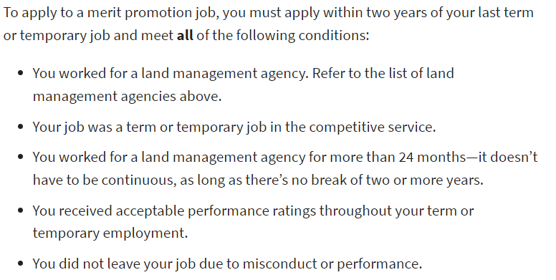
U.S. Fish and Wildlife Service (FWS)
Helpful tips – Experience as a Term to Apply for Permanent Position
Merit Promotion jobs means jobs that are competitive and open to current federal employees (often employees looking for a promotion into their next job)
Merit Promotion jobs = Competitive Service jobs on USAJOBS
While they are usually only open to people who have already worked for federal government, if you have 24 months as a Term employee you can apply for these permanent jobs.
The posting will be listed with this hiring path

Slide 5
U.S. Fish and Wildlife Service (FWS)
Opportunities
Special authorities
Peace Corps and AmeriCorps
Student Conservation Association
Internship
External to FWS but good route to get experience and be eligible for permanent positions

Slide 6
U.S. Fish and Wildlife Service (FWS)
Helpful tips – Series and Grade Eligibility
GS-Series-Grade (Ex: GS-0401-5)
Series: 0400 Biological Sciences
Biological Science Technician (0404)
Fish and Wildlife Biologist (0401)
Fish Biologist (0482)
Wildlife Biologist (0485)
Grade: Based on education/experience
~GS-4 to GS-7 is considered entry-level

Slide 7
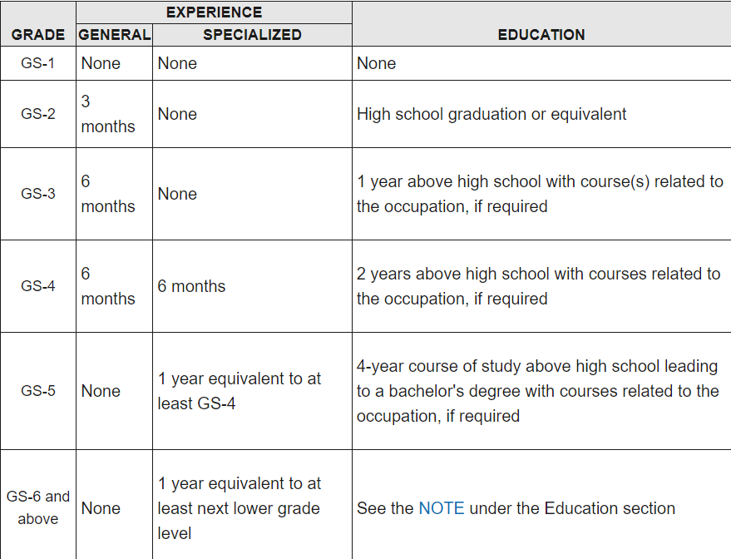
U.S. Fish and Wildlife Service (FWS)
Helpful tips – Grade Eligibility

Slide 8
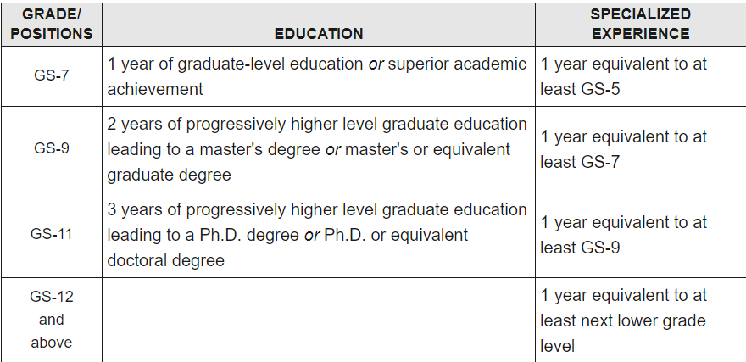
U.S. Fish and Wildlife Service (FWS)
Helpful tips – Grade Eligibility

Slide 9
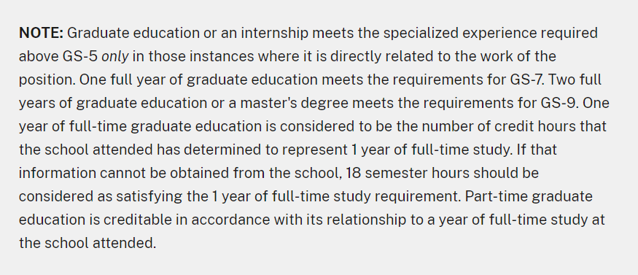
U.S. Fish and Wildlife Service (FWS)
Helpful tips – Grade Eligibility

Slide 10
U.S. Fish and Wildlife Service (FWS)
Vacancy Announcement Example
USAJOBS Biologist

Slide 11
U.S. Fish and Wildlife Service (FWS)
Helpful tips – Submitting Application Package
Read announcement and then read it again
If you don’t include everything listed, you will be disqualified
Use the resume builder in USAJOBS
Tailor resume to specifics in job announcement
How you will be evaluated
Specialized experience
Dual assessment
Include a cover letter
Mention things about yourself that aren’t visible in a resume
Express why you are interested in the position

Slide 12
U.S. Fish and Wildlife Service (FWS)
Helpful tips – Continuous Searches
Notifications for future job announcements
Save a search and set up email notifications
Make resume and profile searchable

Slide 13
U.S. Fish and Wildlife Service (FWS)
Is the job worth the application process?
Equal Opportunity Employer
Benefits
Fair Pay and Leave
Nation-wide Network of Positions
Variety of Job Options
Public Service
Natural Resources Conservation
Be patient with the process.

Slide 14
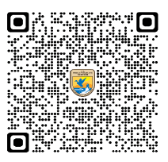
U.S. Fish and Wildlife Service (FWS)
EMPLOYMENT FLYERS
OPPORTUNITY NOTIFICATIONS

Slide 15
U.S. Fish and Wildlife Service (FWS)
Questions?
Please don’t hesitate to reach out –
it’s a lot of information and can be confusing.
Katherine (Kasia) Mullett
katherine_mullett@fws.gov
612-449-0674

